Slide 1
Are We Due for Another Crash?
The Effect of Interest Rates on S&P 500 Yields
Dean Young
11 May 2015

Slide 2
Disclaimer
No part of this analysis constitutes investment advice in any form or fashion.
Invest at your own risk.
The author of this analysis holds a total US stock market index which includes the S&P 500.

Slide 3
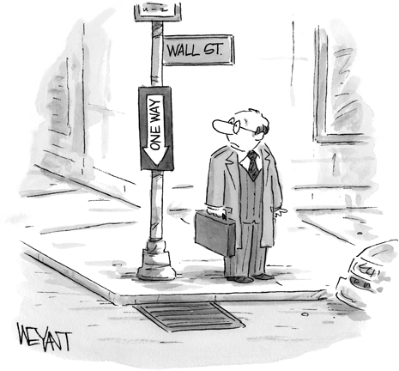
Wall Street?!?!

Slide 4
Why worry about a crash?
Interest rates at historic lows
“Buzz” on Wall Street over high stock valuations
Even Janet Yellen, Warren Buffet agrees

Slide 5
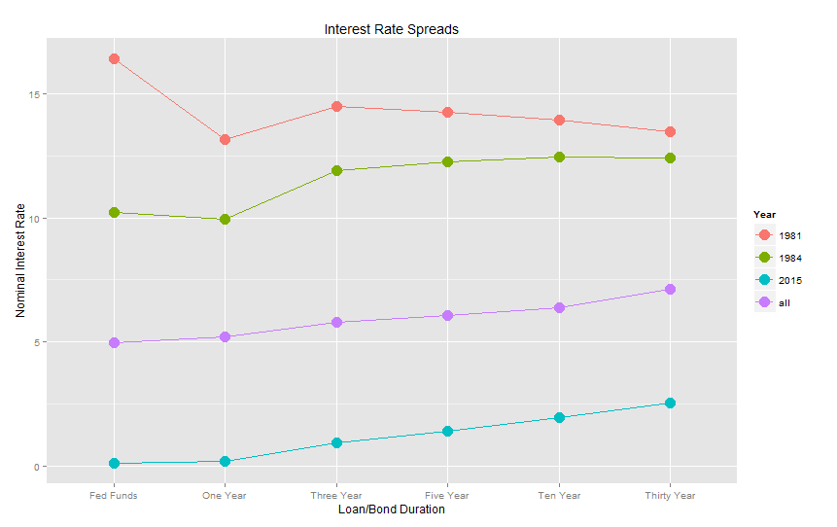
Interest Rate Spreads
Relative, not absolute, interest rates
Based on loan duration and risk profile
Generally, but not always, upward sloping

Slide 6
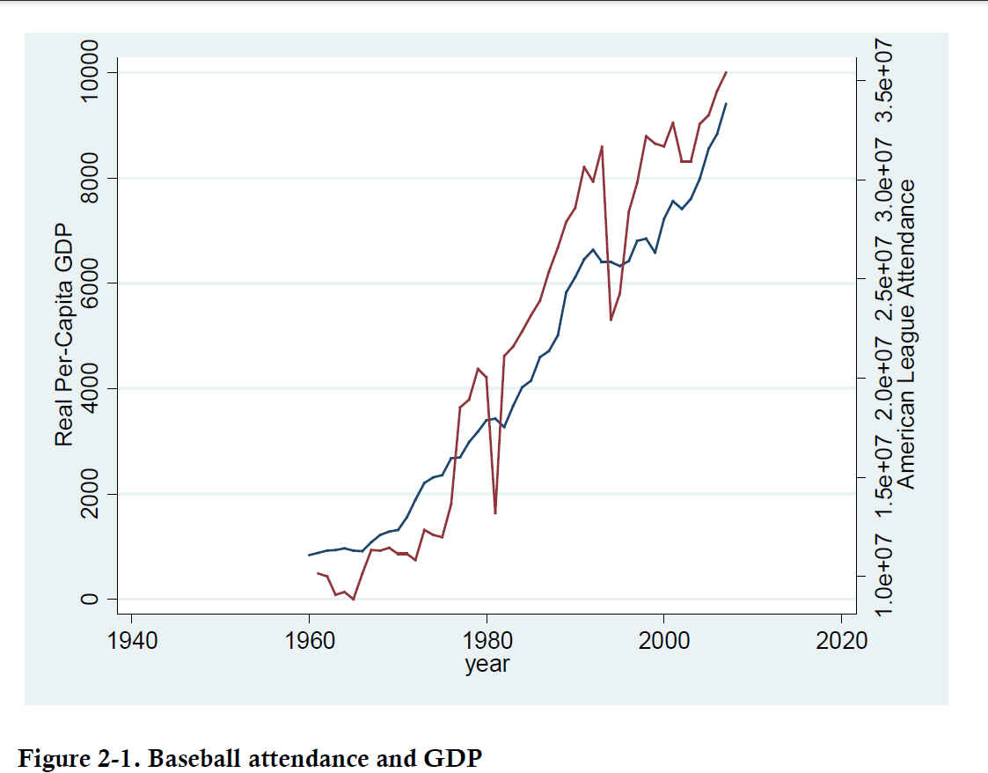
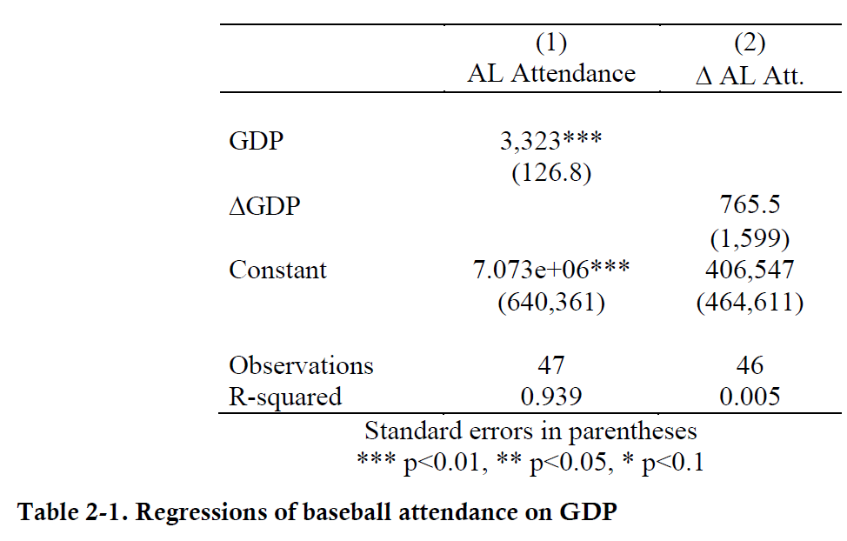
Time Series (ugh…)
Strong correlation?

Slide 7
Time Series (cont.)
DO NOT skip exploratory data analysis!!!
T-tests, p-values, confidence intervals are ALL invalid with non-stationary variables
It’s common to difference non-stationary variables to make them stationary
Stationary variables regress to a mean, non-stationary variables do not

Slide 8
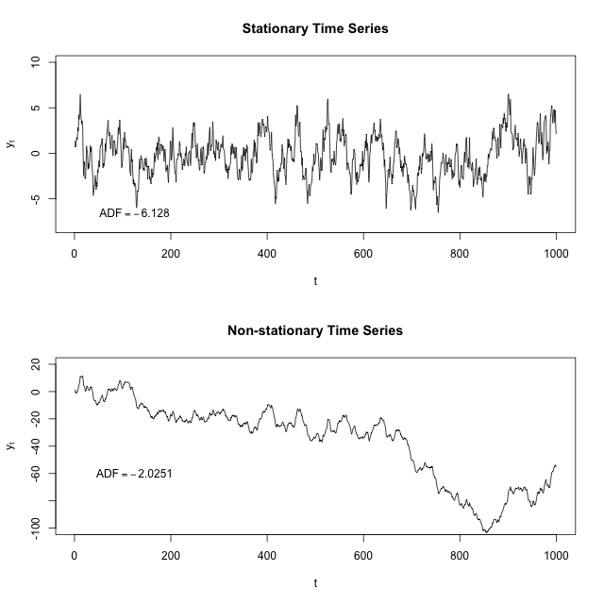
Time Series (cont.)

Slide 9
Data Notes
The bond yield rates are for a 3 year US treasury bond (avg. stock holding period = 3-4 years)
The stock yield rates are for the S&P 500 index
Expected real rates/yields are determined by subtracting previous year's inflation from nominal rates/yields

Slide 10
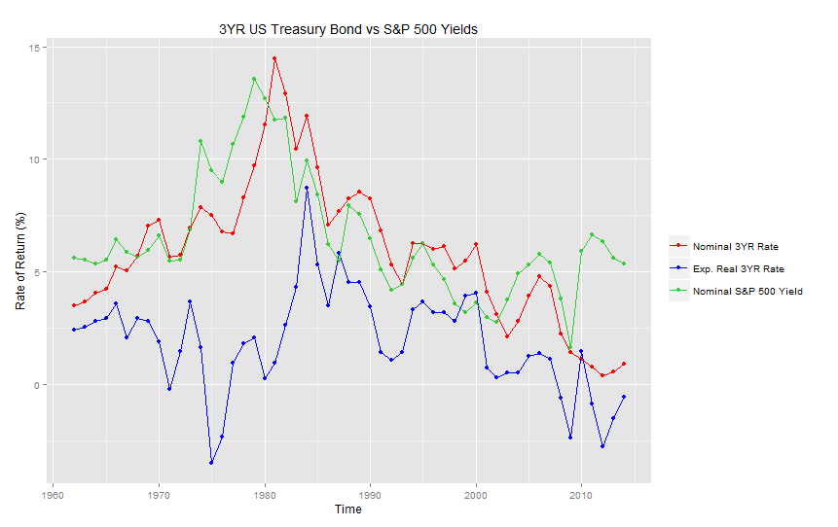
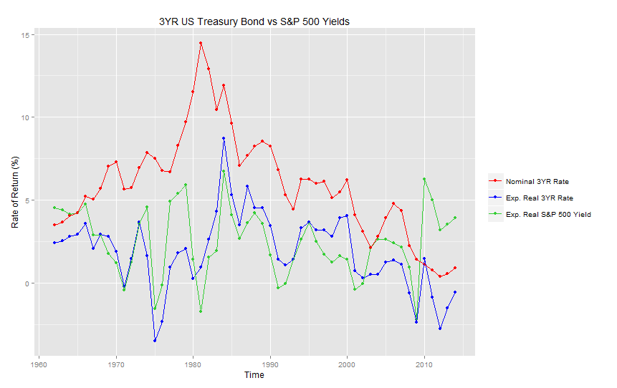
Exploratory Data Analysis
Nominal Stock Yield
Expected Real Stock Yield
https://youngde.shinyapps.io/Bond_Stock_Shiny_App/

Slide 11
Exploratory Data Analysis (cont.)
Bond rates > Stock yields?
80s – hyperinflation fears artificially raised bond rates and lowered stock yields
90s – tech bubble lowered stock yields

Slide 12
Exploratory Data Analysis (cont.)
Augmented Dickey-Fuller Test for stationarity (H₀=non-stationary)
Could not reject null for 3 of 4 series (only rejection was exp. Real stock yield)
Remember: could not reject ≠ accept the null (low power for “sticky” stationary variables)
Difference the variables just in case

Slide 13
Why not always take the difference?
Pros
Taking a difference usually gives a stationary time series
Taking a difference usually gets rid of serial (auto) correlation issues
Cons
Difficult to interpret ("A 1 unit change in the change of X is associated with a 1 unit change in the change of Y")
Makes predictions difficult (inputs are in changes not in actual values)
Loses one degree of freedom

Slide 14
Model Specification
Y_{t} = β₁ + β₂X_{2t} + β₃X_{3t} + ε_{t}
Y_{t} = current nominal (exp. Real) stock yield difference
X_{2t} = current nominal 3yr bond yield difference
X_{3t} = current exp. Real 3yr bond yield difference
No distributed lags
Only used one bond type to avoid multi-collinearity

Slide 15
Results
Overall positive relationship between changes in interest rates and changes in stock yields as expected
Odd case in first model likely due to omitted variable bias
Differencing variables also removed serial correlation

Slide 16
Concluding Thoughts
Fear of market “correction” is reasonable due to potential interest rate hikes
Since earnings don’t adjust quickly, prices of stocks must fall to raise yield
Also possible for prices to grow very slowly in order for earnings to catch up

Slide 17
Data Sources
US Treasury and Fed Funds rates were drawn from Quandl.com via the Quandl package
Inflation data drawn from St. Louis Federal Reserve (FRED)
S&P 500 Yields drawn from multpl.com (pulled from Robert Schiller's book: "Irrational Exuberance")

Slide 18
Information Sources
http://useconomy.about.com/od/glossary/g/Inverted_yield.htm (reasons for inverted yield curve)
http://academic.reed.edu/economics/parker/312/tschapters/S13_Ch_1.pdf (Stationary vs. Non-Stationary time series)
http://academic.reed.edu/economics/parker/312/tschapters/S13_Ch_2.pdf (Breusch-Godfrey test)
http://academic.reed.edu/economics/parker/312/tschapters/S13_Ch_4.pdf (Dickey-Fuller)
http://seekingalpha.com/instablog/604052-element-alpha/65463-proof-that-the-modern-portfolio-theory-should-be-declared-dead (Average stock holding period)
The Intelligent Investor by Benjamin Graham (false belief that stocks are a good hedge for inflation)
Advanced Macroeconomics - 4th Edition by David Romer (modeling expected inflation)
http://www.reuters.com/article/2015/05/06/us-usa-fed-yellen-idUSKBN0NR1JI20150506 (Janet Yellen on valuations)

